Slide 1
CHAPTER -5
PRINCIPLES OF INHERITANCE- MUTATION

Slide 2
INTRODUCTION
Sudden heritable change in genetic material or character of an organism is
known as mutation
Individuals showing these changes are known as mutants
An individual showing an altered phenotype due to mutation are known as
variant
Factor or agents causing mutation are known as mutagens
Mutation which causes changes in base sequence of a gene are known as
gene mutation or point mutation

Slide 3
History
English farmer Seth Wright recorded case of mutation first time in 1791 in
male lamb with unusual short legs
The term mutation is coined by Hugo de Vries in 1900 by his observation in Oenothera
Systematic study of mutation was started in 1910 when Morgan
genetically analyzed white eye mutant of Drosophila
H. J. Muller induced mutation in Drosophila by using X- rays in 1927 ; he
was awarded with Nobel prize in 1946

Slide 4
Characteristics of Mutation
Generally mutant alleles are recessive to their wild type or normal alleles
Most mutations have harmful effect, but some mutations are beneficial
Spontaneous mutations occurs at very low rate
Some genes shows high rate of mutation such genes are called as mutable gene
Highly mutable sites within a gene are known as hot spots.
Mutation can occur in any tissue/cell (somatic or germinal) of an organism

Slide 5
Chromosome Mutations
May Involve:
– Changing the structure
- loss or gain

Slide 7
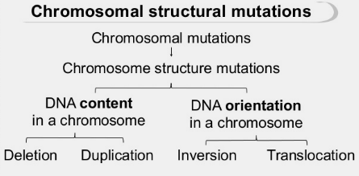
TYPES OF CHROMOSOMAL MUTATION

Slide 9
Deletion Mutation
Due to breakage
A piece of a chromosome is lost

Slide 10
Inversion Mutation
Chromosome segment
breaks off
Segment flips around
backwards
Segment reattaches

Slide 11
Duplication mutation
Occurs when a gene sequence is repeated

Slide 12
Translocation mutation
Involves two chromosomes that aren’t homologous
Part of one chromosome is transferred to another chromosomes

Slide 13
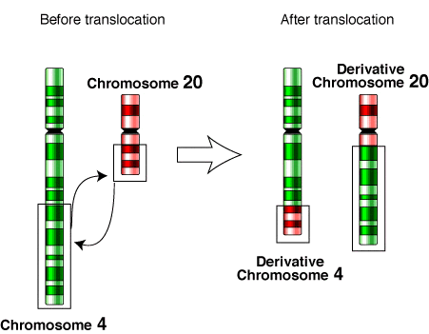

Slide 15
Non- disjunction
Failure of chromosomes to separate during meiosis
Causes gamete to have too many or too few chromosomes
Disorders:
Down Syndrome –
Turner Syndrome –
Klinefelter’s Syndrome –

Slide 16
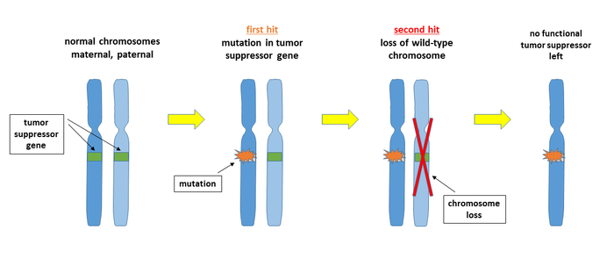
Non disjunction mutation

